Slide 1



BUSINESS PROPOSAL (cont.)

Slide 2
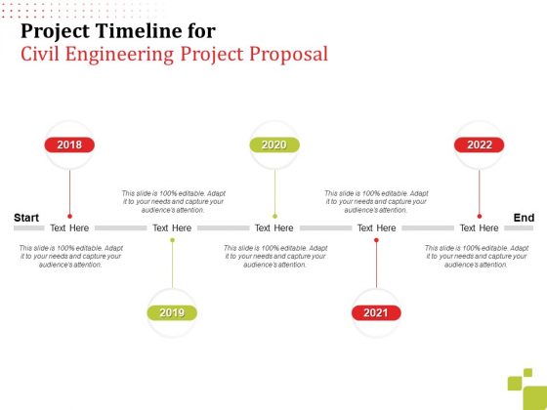
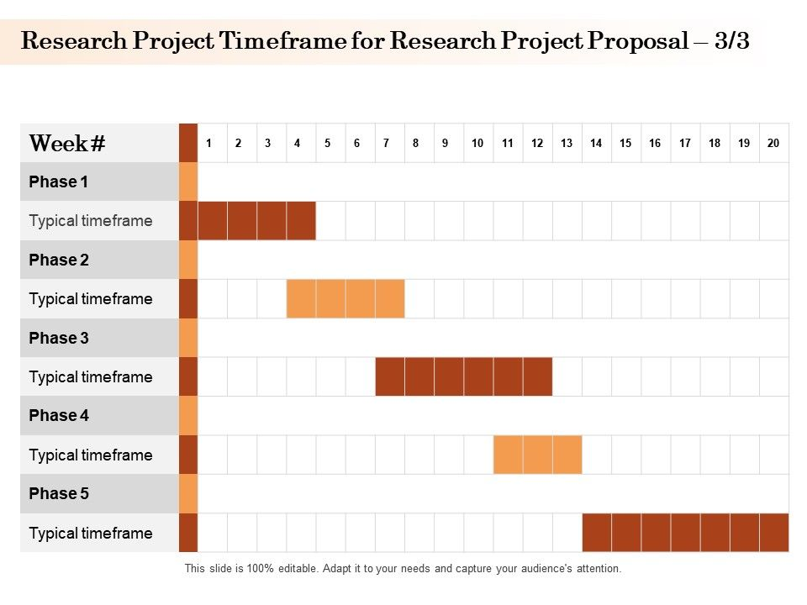
TRADITIONAL CATEGORIES OF PROPOSAL
7. TIMELINE
A clear presentation, often with visual aids, of the process, from start to finish, with specific, dated benchmarks noted.

Slide 3
Sample of a Milestone Timeline
Draft blueprints
Run focus groups
Gather feedback
Feb 2022
May 2022
Oct 2022
2022
JAN
FEB
MAR
APR
MAY
JUN
JUL
AUG
SEP
OCT
NOV
DEC
2023
JAN
FEB
MAR
APR
MAY
JUN
JUL
AUG
SEP
OCT
NOV
DEC
Test design
Launch design
Deliver to client
Feb 2023
July 2023
Dec 2023

Slide 4
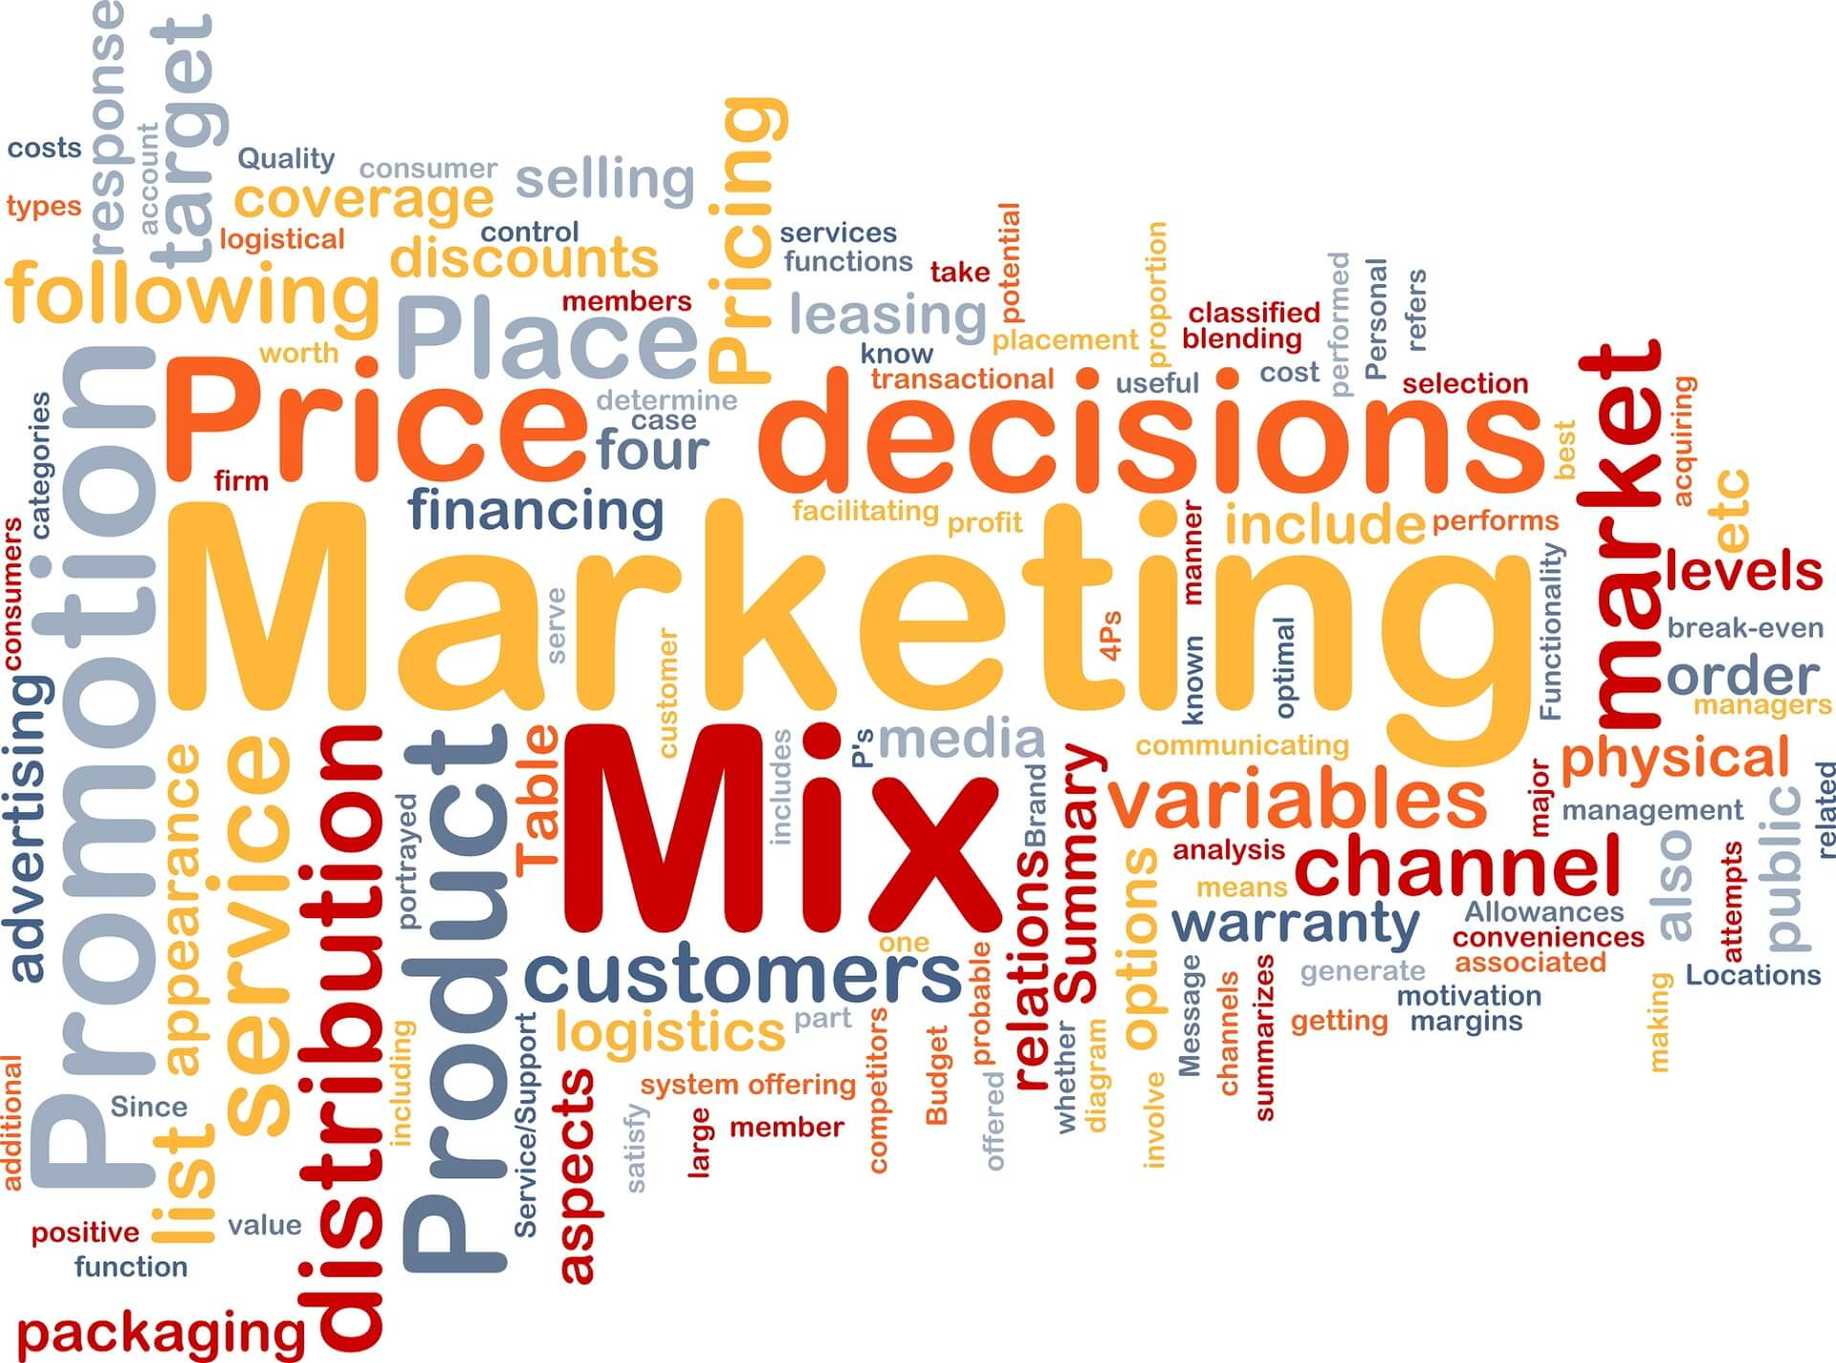
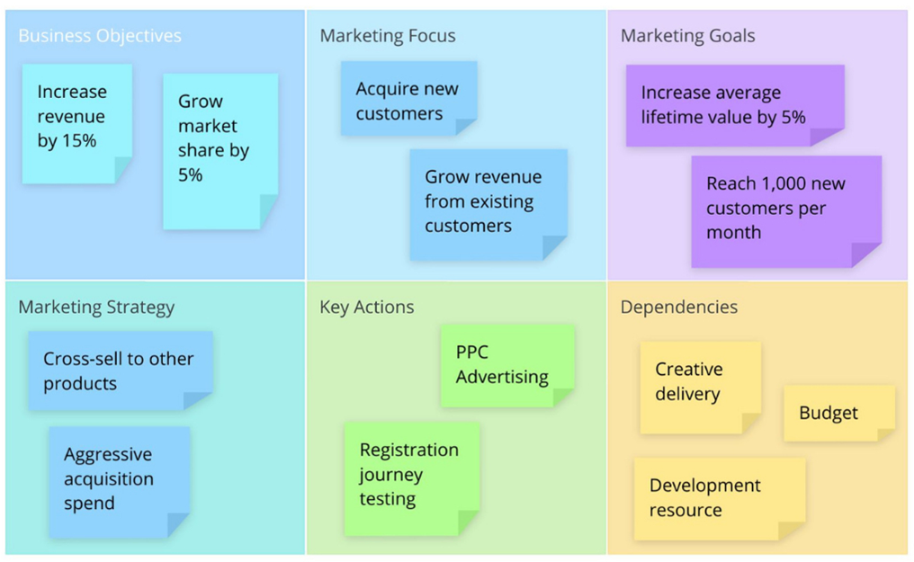
TRADITIONAL CATEGORIES OF PROPOSAL
8. The Marketing Plan
Delivery is often the greatest challenge for Web-based services. How will people learn about you?
If you are bidding on a gross lot of food service supplies, this may not apply to you, but if an audience is required for success, you will need a marketing plan.

Slide 5
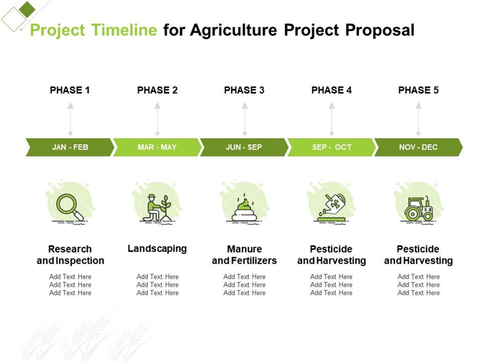
Let’s practice!
Let’s discuss and write the timeline and marketing plan of the project.

Slide 6

TRADITIONAL CATEGORIES OF PROPOSAL
9. FINANCE
What are the initial costs, when can revenue be anticipated, when will there be a return on investment (if applicable)?
Again, the proposal may involve a one-time fixed cost, but if the product or service is to be delivered more than once and extended financial plan noting costs across time is required.

Slide 7
Sample Financials
Key metrics
Revenue by year
 | Clients | Orders | Gross revenue | Net revenue
2022 | 10 | 1100 | $10,000 | $7,000
2023 | 20 | 200 | $20,000 | $16,000
2024 | 30 | 300 | $30,000 | $25,000
2025 | 40 | 400 | $40,000 | $30,000

Slide 8
Sample Financials table
DESCRIPTION | YEAR 1 | YEAR 2 | YEAR 3 | DELTA
Income
Users | 50,000 | 400,000 | 1,600,000
Sales | 500,000 | 4,000,000 | 16,000,000
Average price per sale | 75 | 80 | 90
Revenue @ 15% | 5,625,000 | 48,000,000 | 216,000,000
Gross profit | 5,625,000 | 48,000,000 | 216,000,000
Expenses
Sales & marketing | 5,062,500 | 38,400,000 | 151,200,000 | 70%
Customer service | 1,687,500 | 9,600,000 | 21,600,000 | 10%
Product development | 562,500 | 2,400,000 | 10,800,000 | 5%
Research | 281,250 | 2,400,000 | 4,320,000 | 2%
Total expenses | 7,593,750 | 52,800,000 | 187,920,000

Slide 9
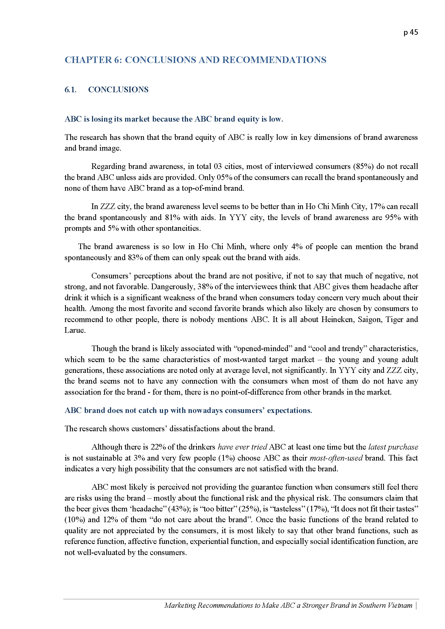
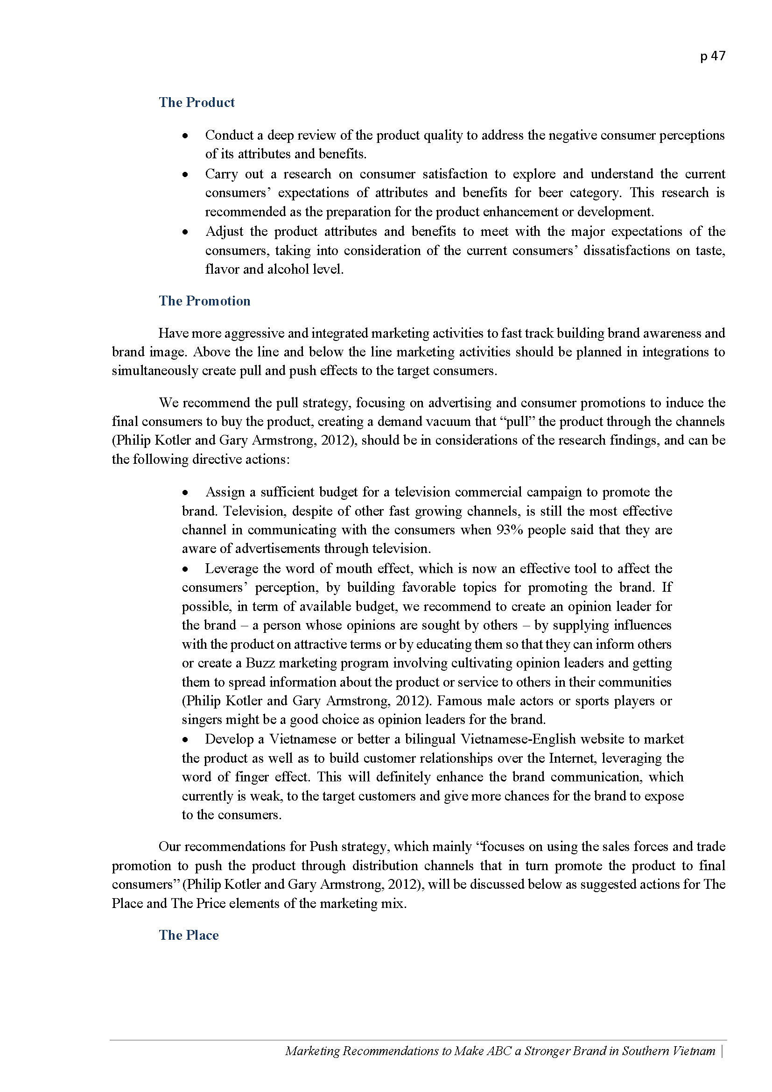
TRADITIONAL CATEGORIES OF PROPOSAL
10. CONCLUSION
Like a speech or essay, restate your main points clearly.
Tie them together with a common them and make your proposal memorable.

Slide 10
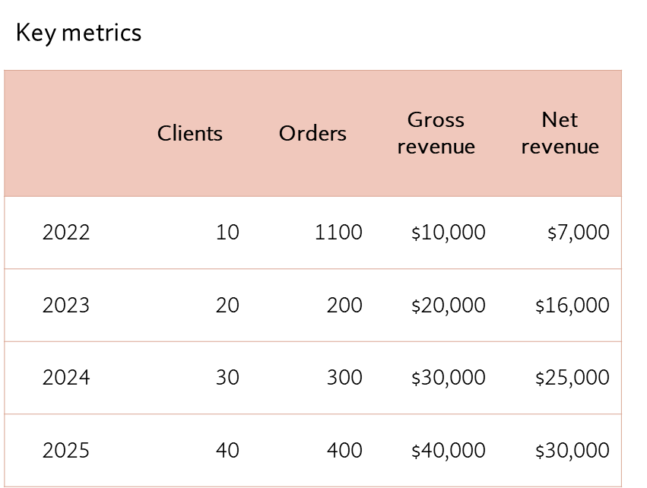
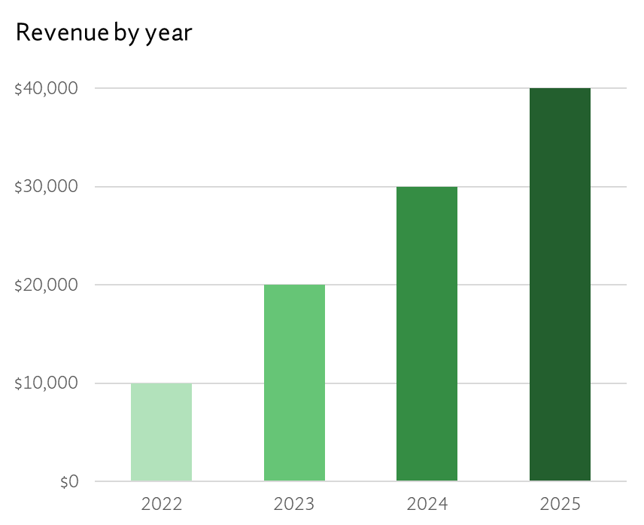
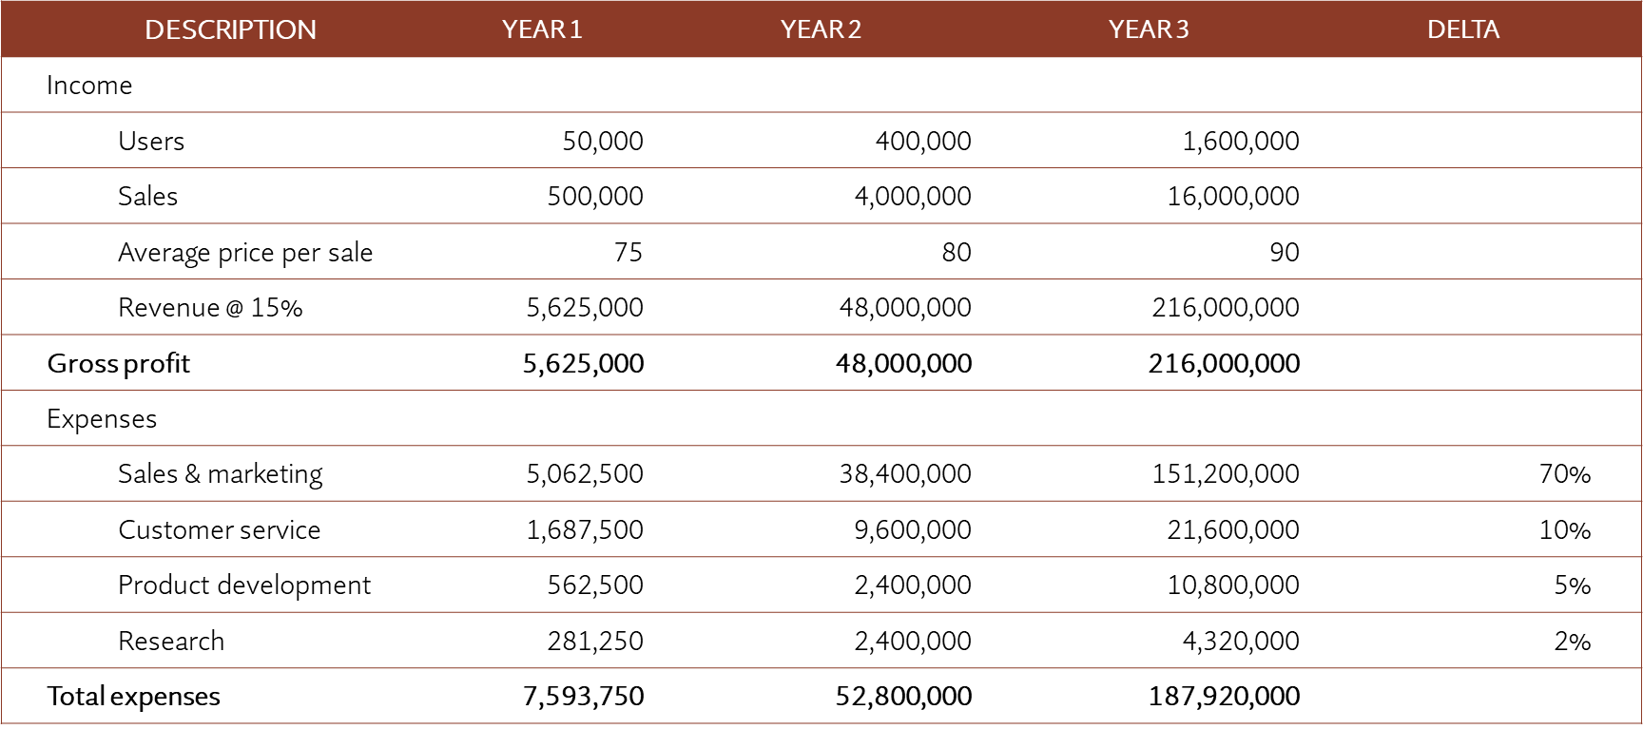
Let’s practice!
Let’s discuss and compose the finance and conclusion of the project.

Slide 11
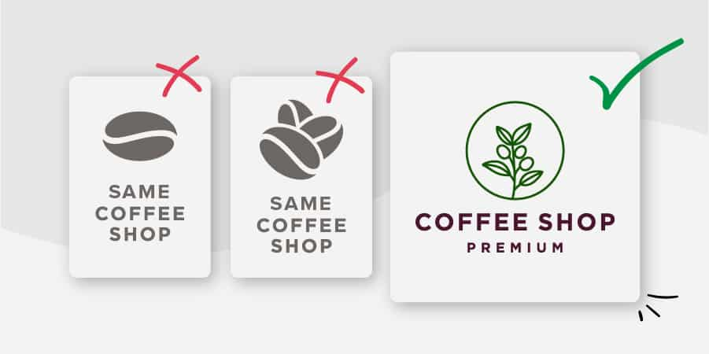
Ethos, Pathos, and Logos
Ethos refers to credibility
Pathos refers passion and enthusiasm
Logos refers logic or reason
Let’s practice! Create your own business logo.

Slide 12

Activity
Create your Team Project’s Logo

Slide 13

Professional
A professional document is a base requirement:
Should be no errors in spelling or grammar
Be concise, accurate, and clearly referenced
Should be easy to find and clearly relevant, including contact information.

Slide 14
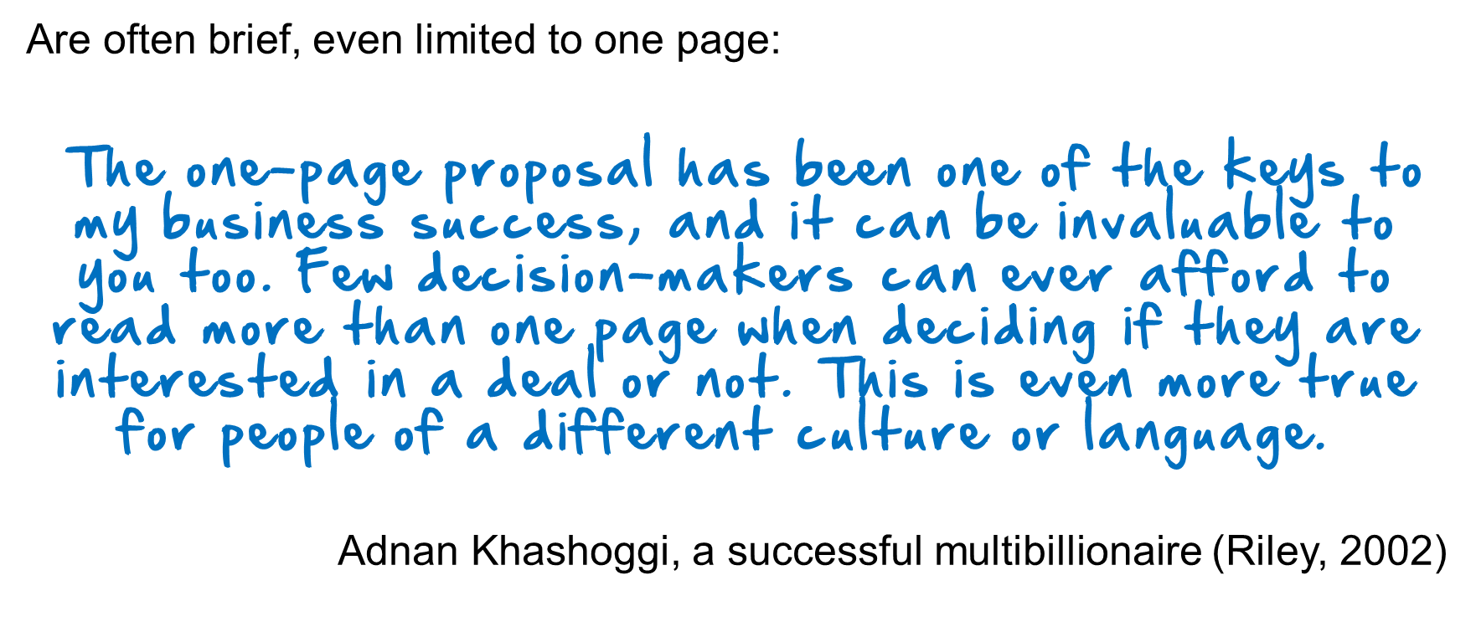
Persuasive proposals

Slide 15
Two Types of Business Proposals
Solicited
Unsolicited
If you have been asked to submit a proposal it is considered solicited.
May come in the form of a direct verbal or written request
Unsolicited proposals are the “cold calls” of business writing.
Required a thorough understanding of the market, product and/or service, and their presentation is typically general rather than customer-specific.

Slide 16

Sample Business Proposal
The Writing Help Tools Center is a commercial enterprise, and offers a clear (and free) example of a business proposal here:
http://www.writinghelp-central.com/sample-business-proposal.html

Slide 17
Finalize your project proposal
Prepare a draft business proposal in no more than 2 pages.
Do not include actual contact information. Just as the example has employees named after colors, your (imaginary) company should have contact information that does not directly link to real businesses or you as an individual.

Slide 18


